Slide 1

eHospital Systems
A Hospital Management Software
Submitted By Business Development Department, Adroit Infosystems

Slide 2


Adroit Infosystems is Software Solutions Provider to Health Care domain in USA and Canada. We have Offices in Noida and USA and Development Center in Noida, India.
Adroit Infosystems is a fast-growing Software Product Development and IT Services company providing full-spectrum software product development services to enterprises worldwide.

Slide 3

Developing USA/Canada/India Healthcare products and providing IT Services since 2008
Knowledgeable and experienced software engineers and managers are well-versed with healthcare software across the global market
Multi-Channel 24x7 Technical Support, supplements a client’s internals support staff
16+ years of USA Health Care Domain experience. 80+ years of collective health care domain experience
40+ Health Care facilities running on Health Care Product developed by Adroit
Timely delivery of all assigned projects. Financially strong to support uninterrupted product development while awaiting customers’ payments
Software Installation Support, Hardware and Software Troubleshooting, Issue resolution and Ticket Management

Slide 4
eHospital Systems - Hospital Management Software
A comprehensive, integrated a hospital management software designed to manage all the aspects of a hospital operations.
Web based solution that supports both Cloud based or On-Premise Installation.
Data security, HIPAA compliant, Technologically Advanced
Easy access from smart phone, tablets, laptops

Slide 5
Benefits of eHospital Systems
It helps as a decision support system for the hospital authorities for developing comprehensive health care policies.
Efficient and accurate administration of finance, diet of patient, engineering, and distribution of medical aid. It helps to view a broad picture of hospital growth.
Improved monitoring of drug usage, and study of effectiveness. This leads to the reduction of adverse drug interactions while promoting more appropriate pharmaceutical utilization.
Enhances information integrity, reduces transcription errors, and reduces duplication of information entries.
Hospital software is easy to use and eliminates error caused by handwriting.
Easy accessible EMR and EHR for better patient care. Internet-based access patient records improves the quality of care even if caregivers are at remote locations.

Slide 6
eHospital Systems : Complete Module Detail
Online Appointment Management | OPD Management | IPD Management | Diagnostic Management | Pharmacy Management
Purchase & Supply Management | Store & Inventory Management | HR & Payroll Management | Financial Accounting | TPA & Insurance
Blood Bank | Diet Management | Doctor Accounting | Electronic Medical Record (EMR) | Guest Management
Healthcare Package | Nurse Station | Software Management | Housekeeping/ Laundry | MIS

Slide 7


Slide 8
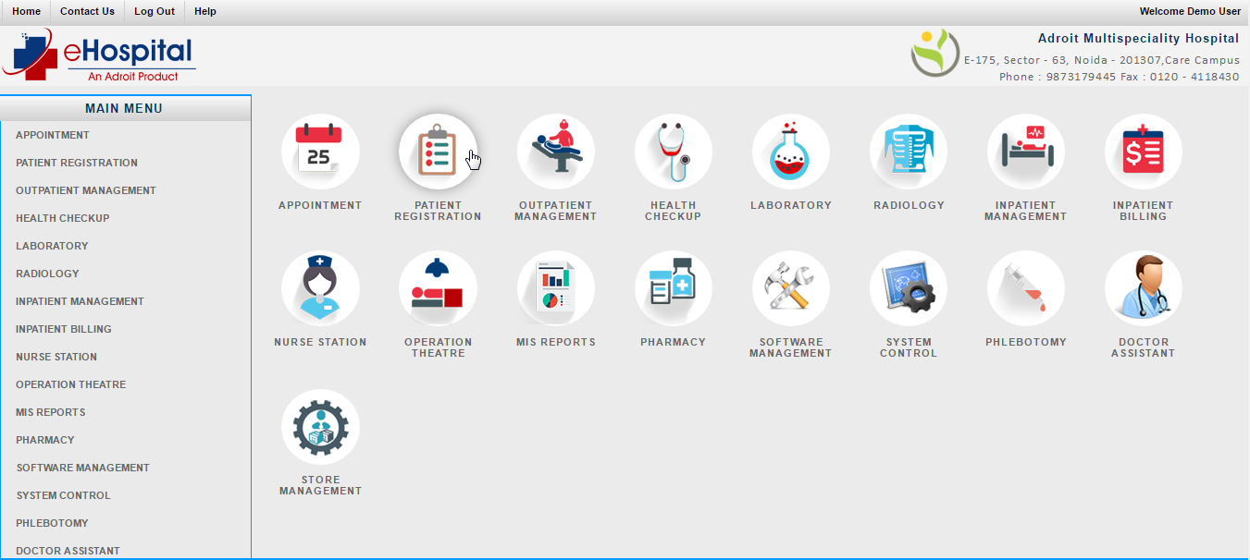

Slide 9

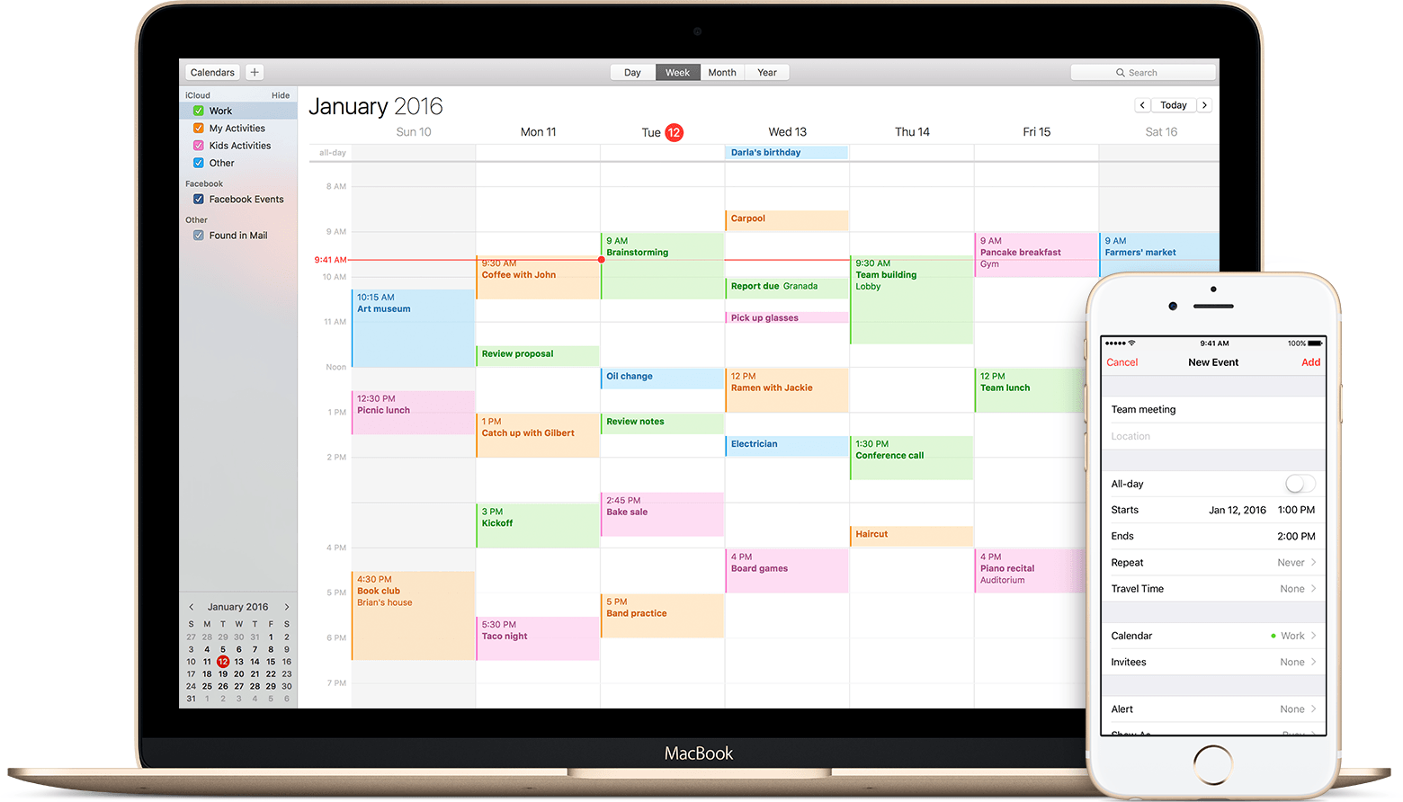
Online Appointment Management
Appointments
Appointment List
Doctor Availability
Doctor leave
Hospital Tariff
Machine Appointment
Machine List

Slide 10
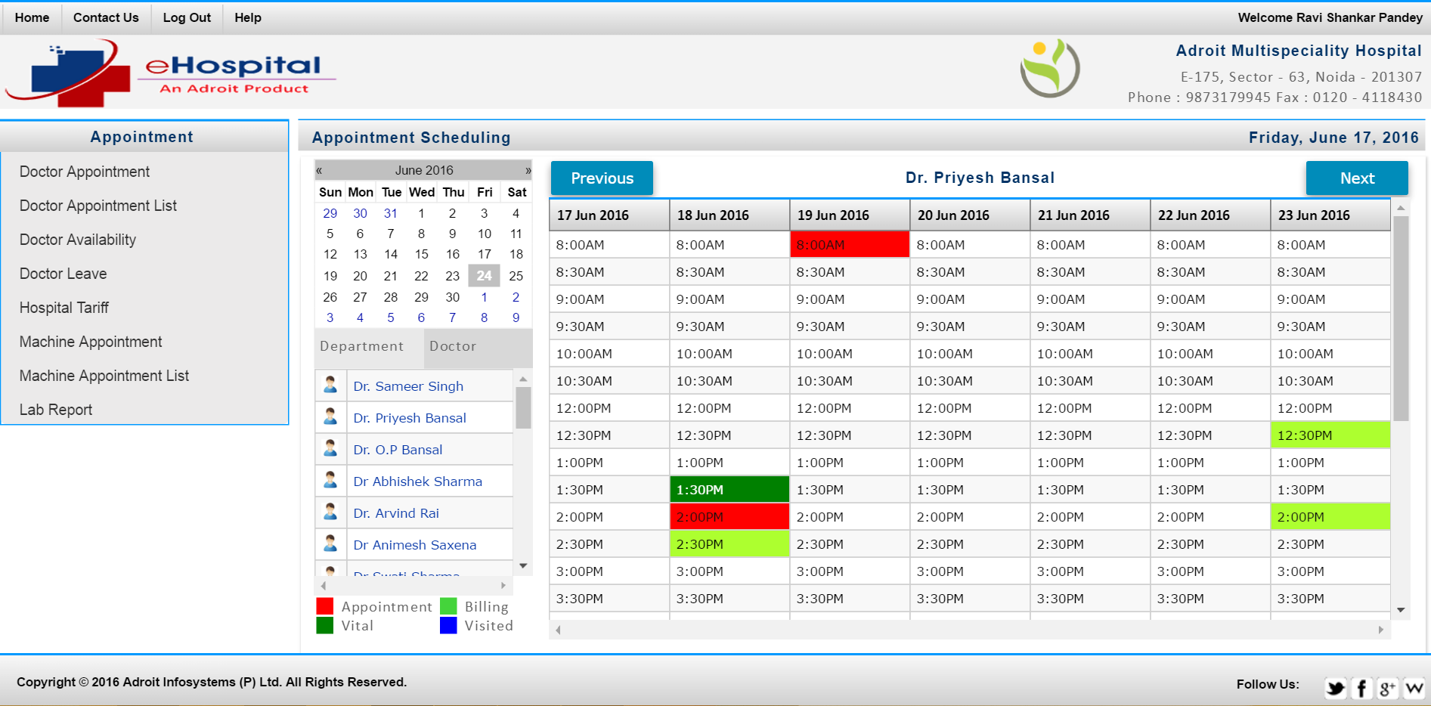

Slide 11

OPD Management
Patient Registration
Patient Search
OPD Billing
OPD Refund
Credit Bill Settlement
Hospital Tariff
MIS Report

Slide 12
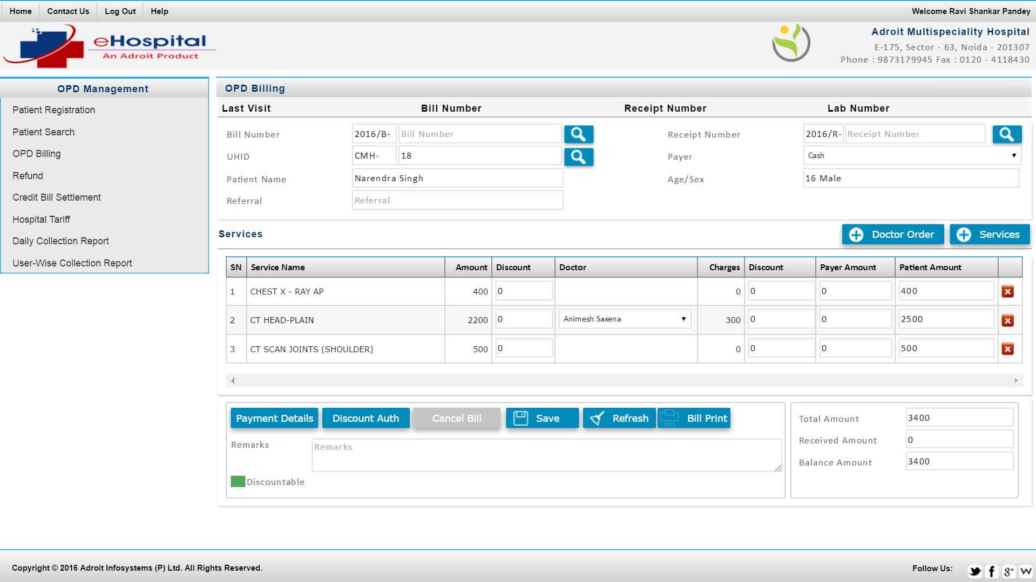

Slide 13

IPD Management
Patient Registration
Patient Admission
Doctor Transfer
Bed Transfer
Bed Status
Patient Discharge
Release charge Bed
New Born Baby
MIS Report

Slide 14
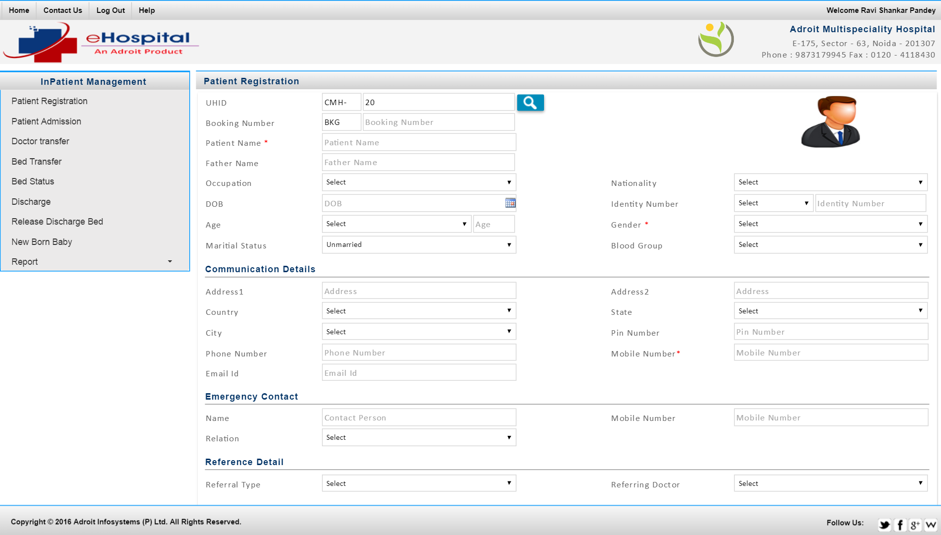

Slide 15

IPD Billing
Patient Billing
Advance Collection
Credit Bill Settlement
Charge Ship Order Entry
Surgery Ship Order Entry
Doctor Visit Entry
Treatment Limit

Slide 16
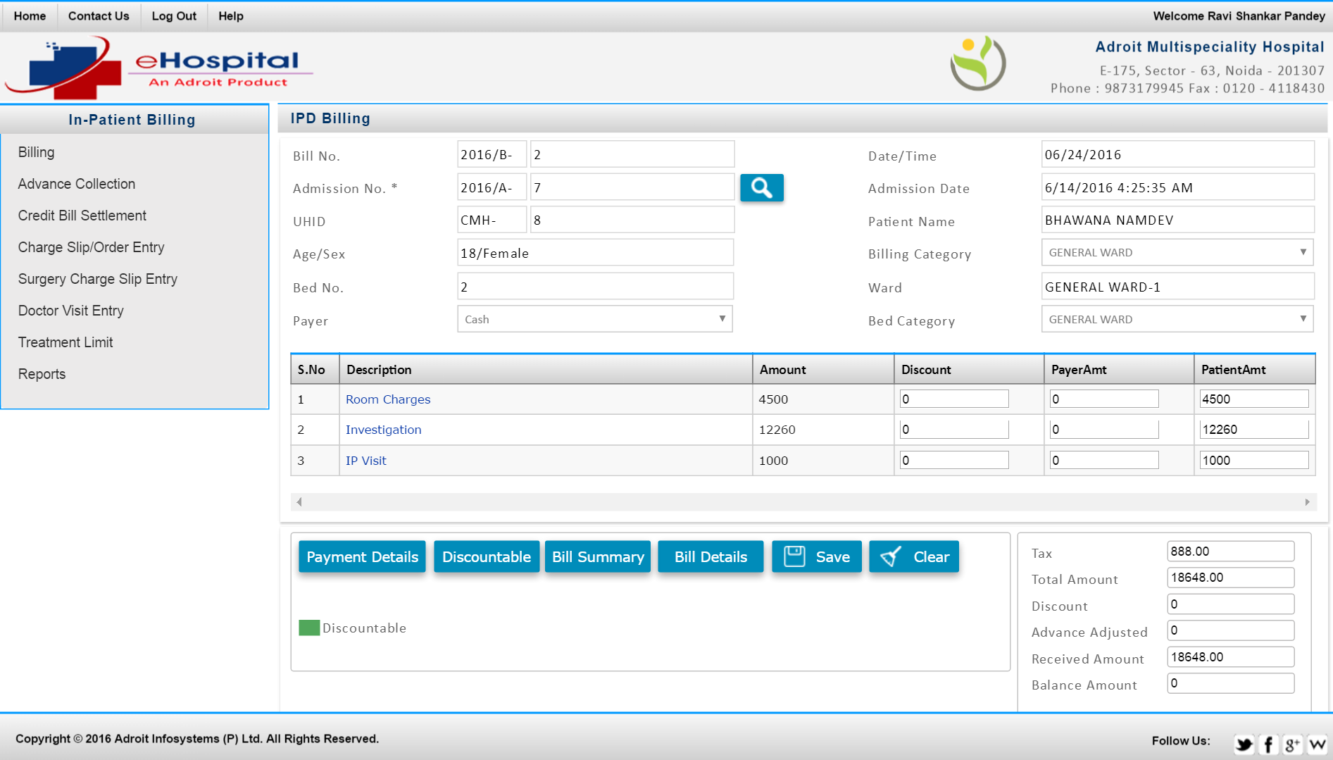

Slide 17

Nurse Station
Major Complaint Entry
Vital Sign
Medical History
Signs & Symptoms
Physical Examination
Diagnoses
Management Plan
Service Charge Ship
Doctor Visit
Nurse Note
Discharge Summary
Nurse Activity Report

Slide 18
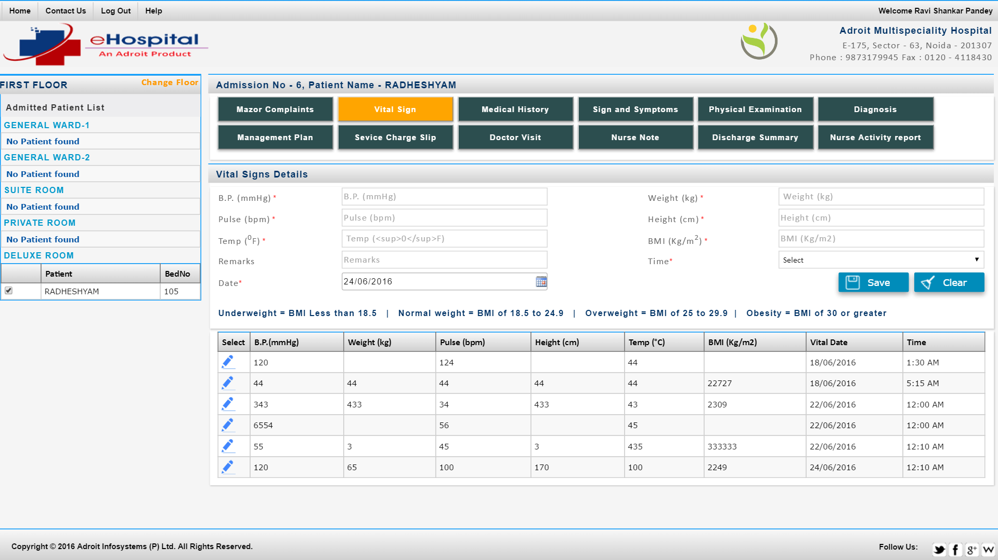

Slide 19
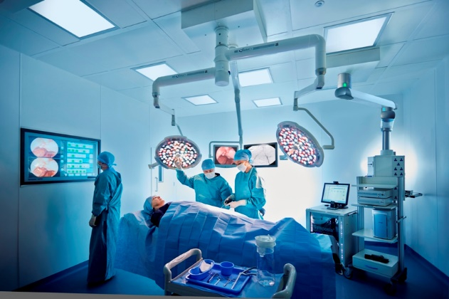
Operation Theater
Tracks all surgeries performed in the hospital
Optimizes theater schedules
Overview of assigned surgeons and nurses for surgery
Records of surgery details and checklists associated
Electronic consent of the patient or the relatives
Maintains pre and postoperative conditions data
CPT codes for all the procedures carried out

Slide 20

Laboratory Department
Investigation Information
Sample Collection
Result Entry
Report Finalization
Report Print
Report Dispatch
Lab Services Register
Report Upload Wizard

Slide 21
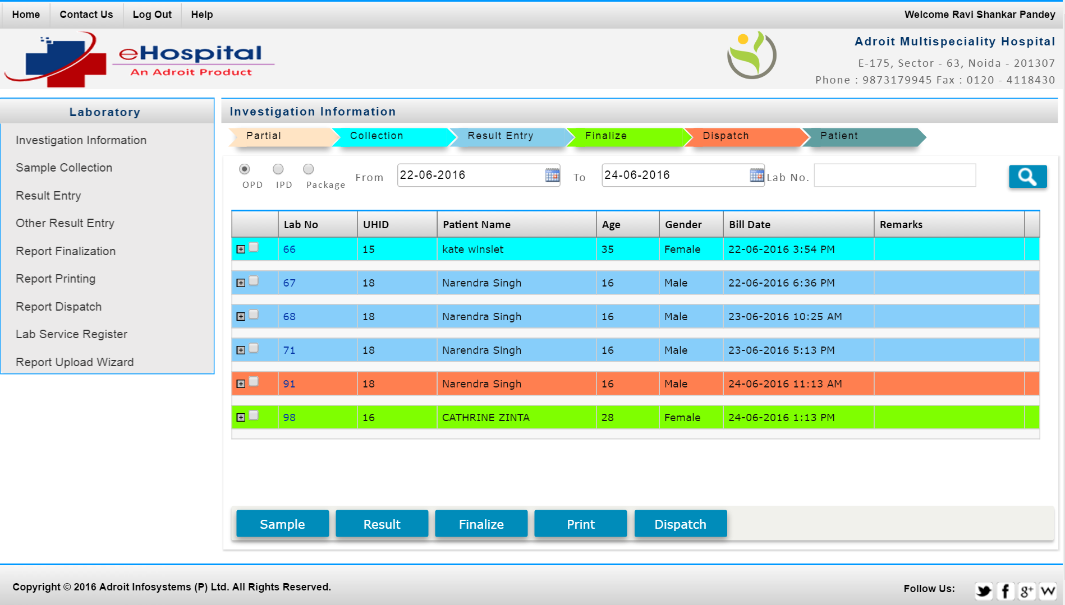

Slide 22
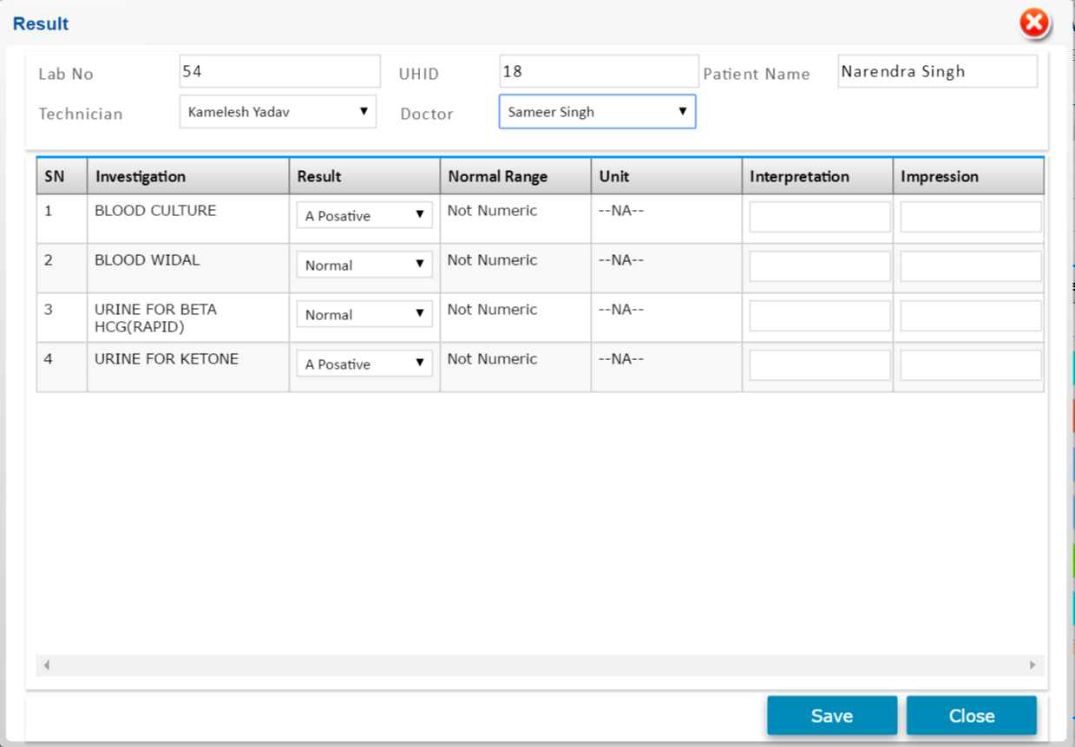

Slide 23
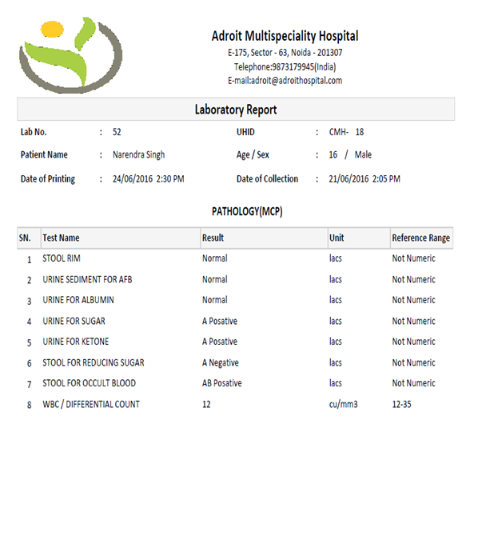

Slide 24
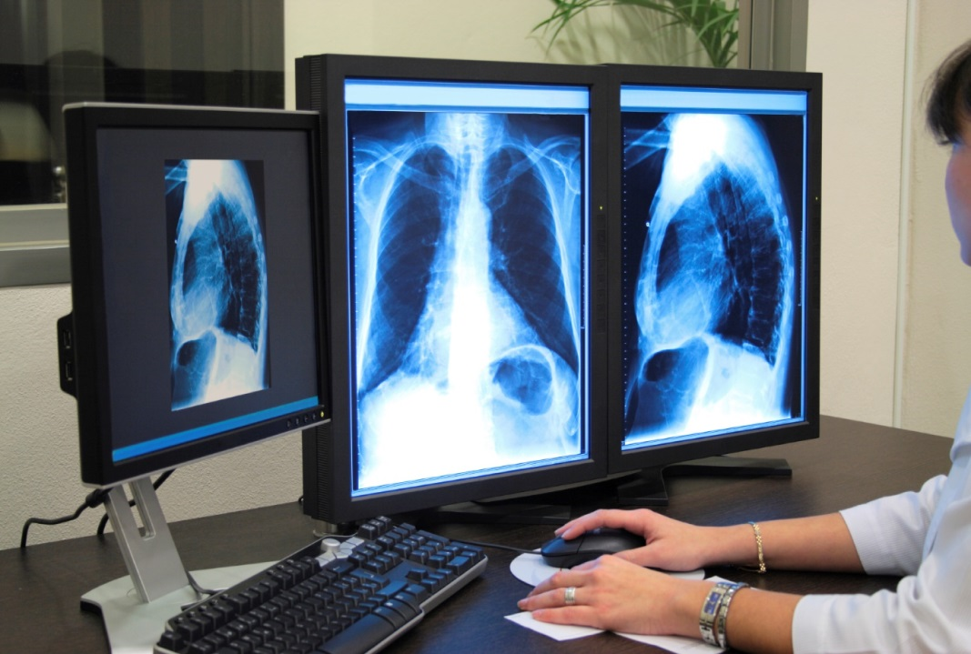
Radiology Department
Investigation Information
Test Acknowledgement
Result Entry
Report Finalization
Report Print
Report Dispatch
Lab Services Register
Lab Report

Slide 25
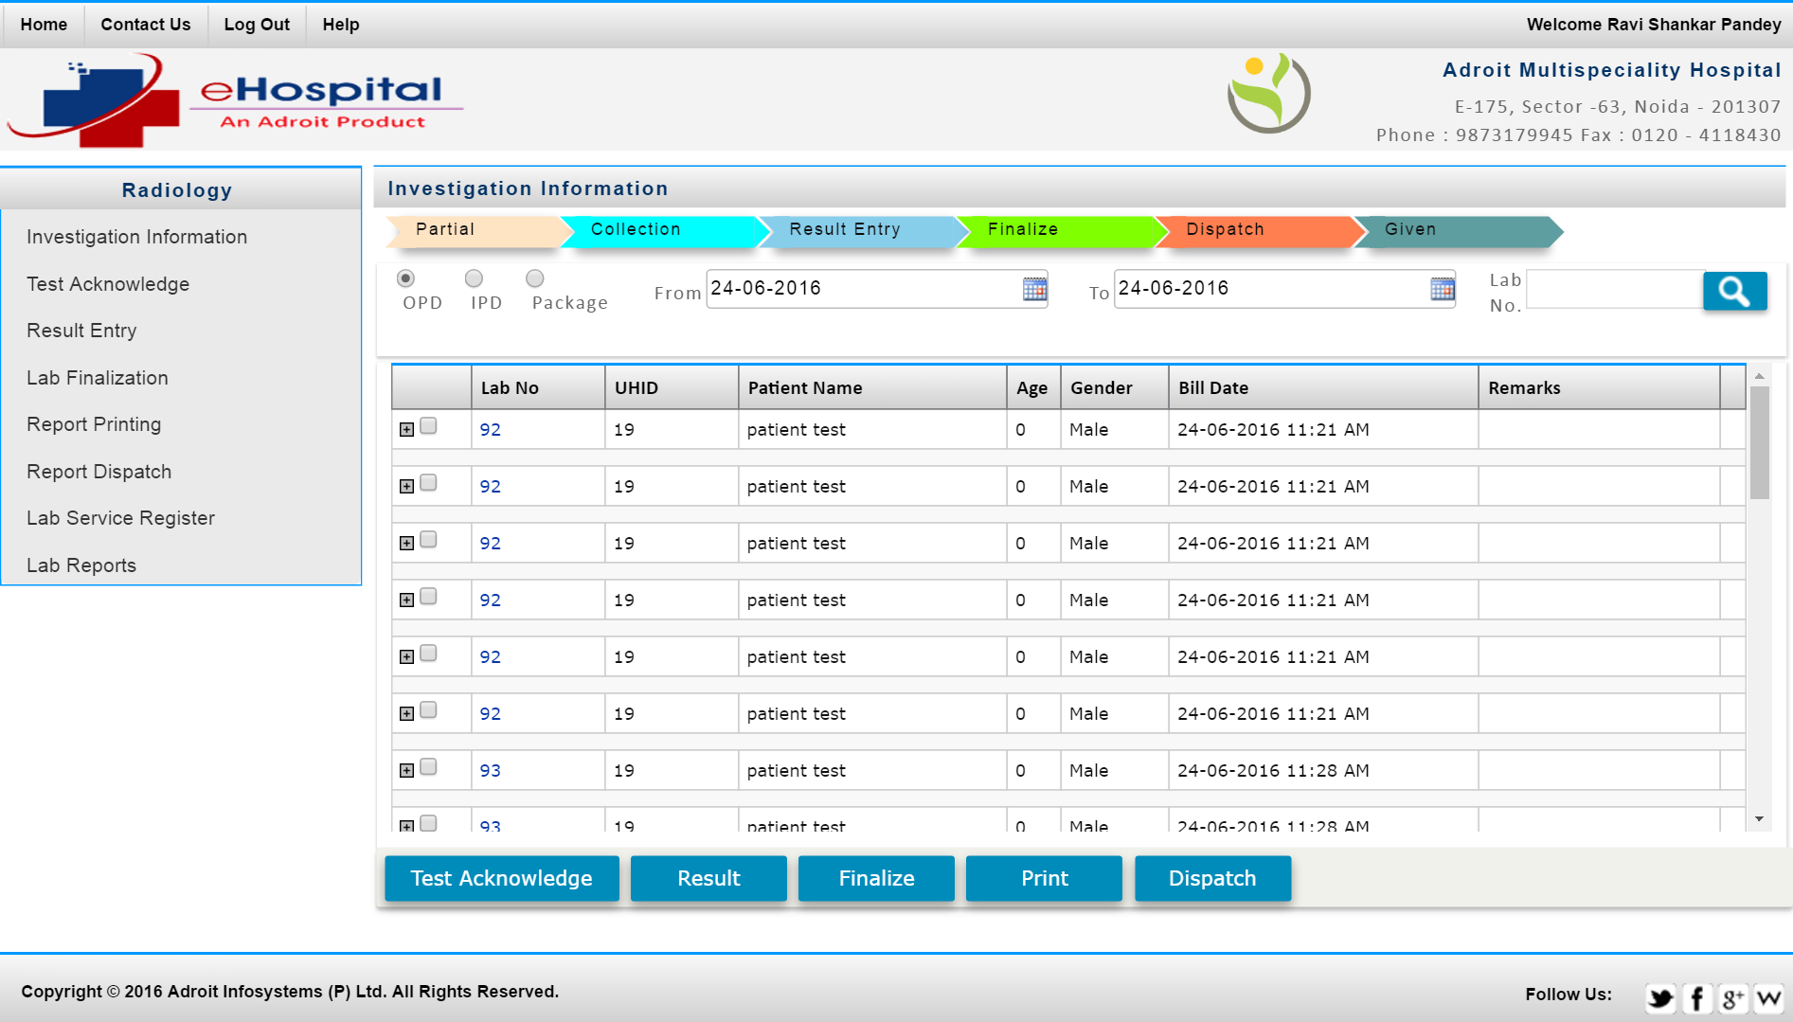

Slide 26
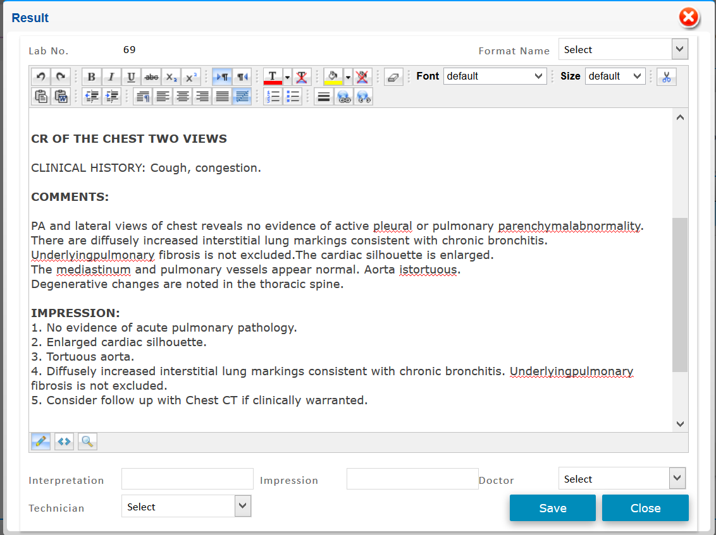

Slide 27
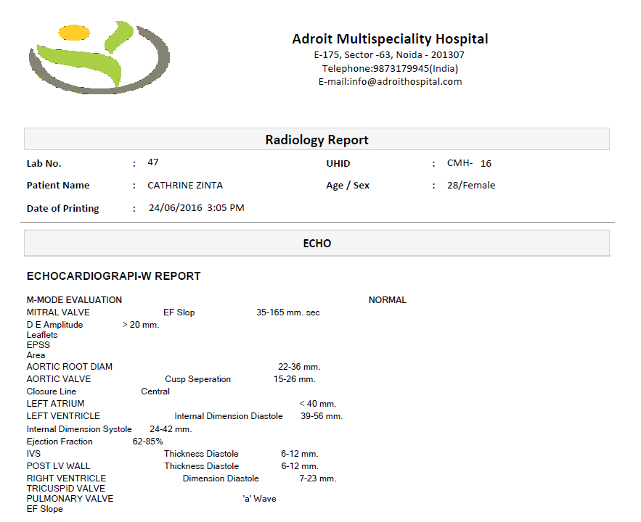

Slide 28
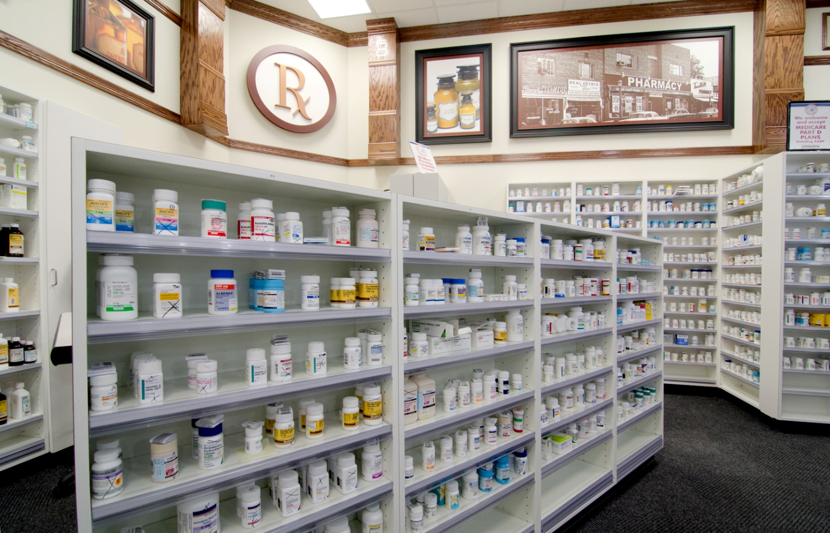
Pharmacy Management
Pharmacy Setup
Purchase Order
Stock Receiving (GRN)
Point of Sale
Sale Return
Expiry Medicine list
Current Item Stock
Report

Slide 29
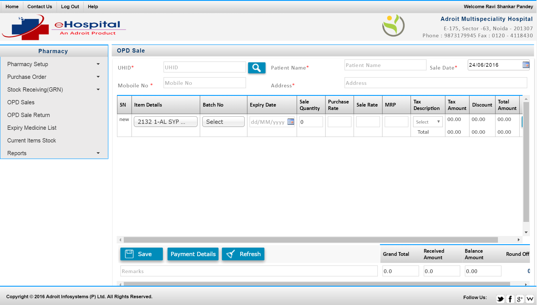

Slide 30
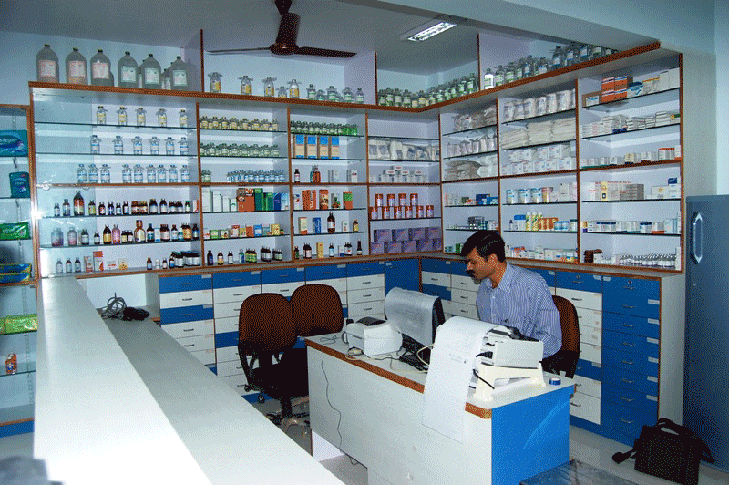
Store & Inventory Management
Request for new stock from stores to head office
Head office issues purchase orders to the vendor
Vendor ships the goods
Warehouse receives the goods
Warehouse stocks and distributes to the stores
Stores receive the goods
Goods are sold to customers at the stores

Slide 31

HR & Payroll Management
A cost-effective, reliable solution to Manage personnel and payroll
Employee earning and deduction, salary, leave details, prepare appointment and recruitment letter
Monitors employees' attendance details, and track attendance
Manages budgets and provides Custom reports

Slide 32

Financial Accounting
Ascertainment of result of above recorded.
Ascertainment of the financial position of business.
Providing information to the users for rational decision-making.
To know the solvency position by preparing the balance sheet
Systematic recording of transactions.

Slide 33
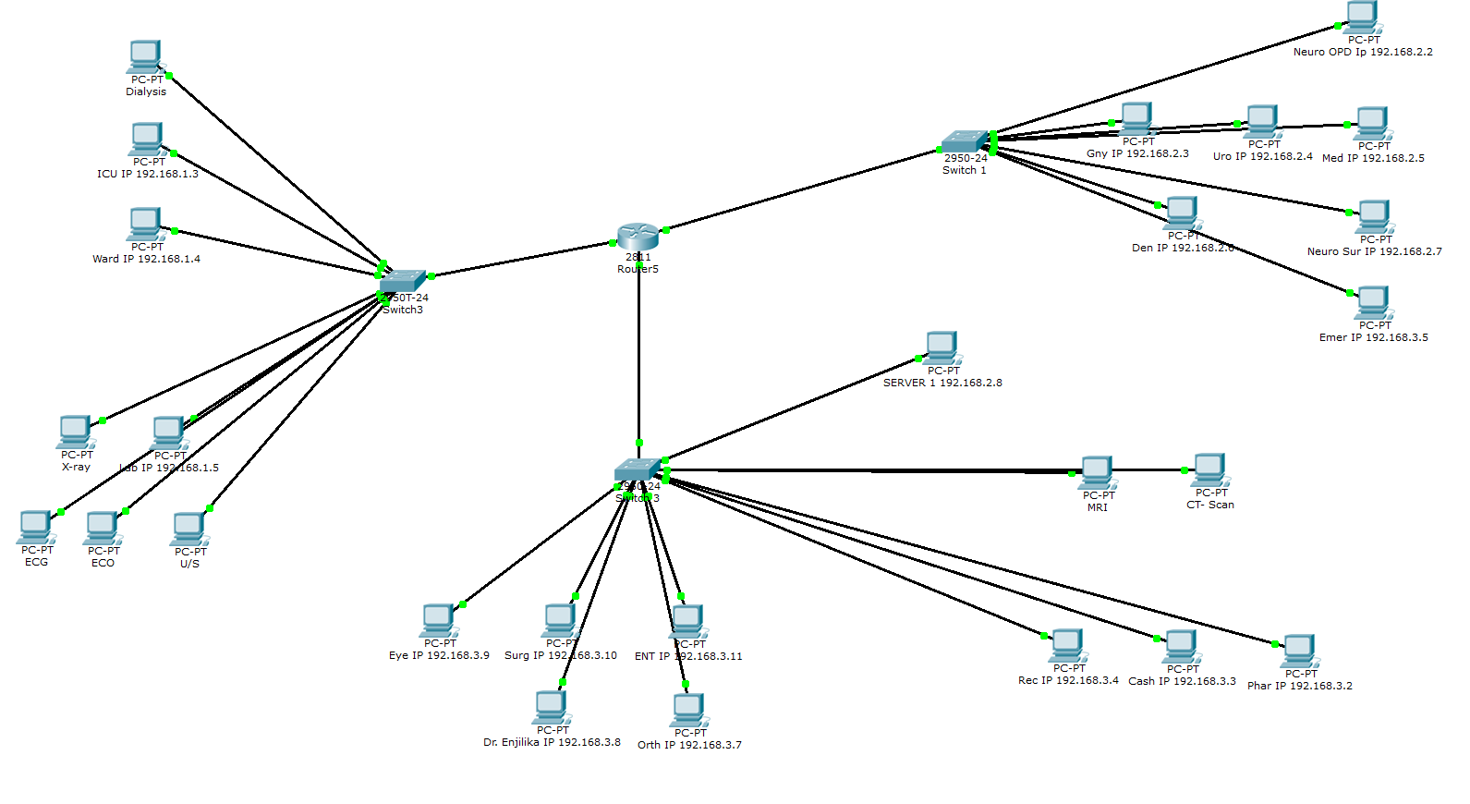
Client Server LAN Networking

Slide 34
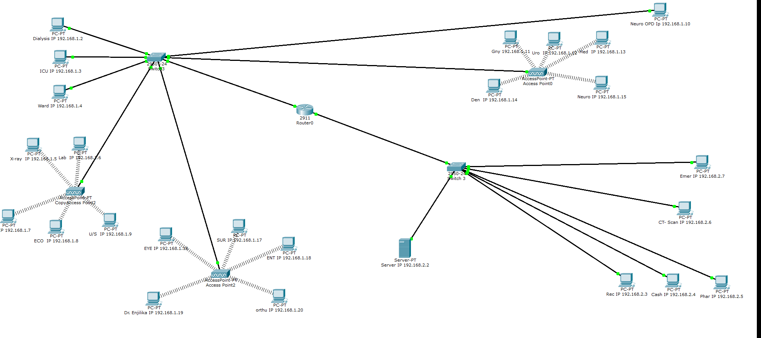
Client Server LAN / Wireless Networking

Slide 35
Hardware / Software Requirement
eHospital Software is a web based software can be installed on premise or on the cloud
Uses SQL Server 2014 Database (Free License for Express Version) and Microsoft IIS
For Cloud installation a reliable high speed internet is recommended
For On-Premise installation a windows machine is needed
Server Configuration (Only for On-Premise)
Windows 2000, Windows XP, Windows 2007, Windows 2008.
Server shall be ZEON or above with 2 GB RAM or higher with minimum 20 GB Hard Disk space.
User Machine Configuration
Any desktop, laptop or smart device have Internet browsing capabilities via Internet Explorer IE 9, Firefox or Chrome.
Adobe Acrobat (PDF) file reader version 9 or higher.

Slide 36

Our Client
Radiant Eye Hospital, Sri Lanka
Sanjeevan Multispecialty Hospital, New Delhi, India
SDM Hospital, Kenya
Complia Health, USA and Canada
Kisumu Specialist Hospital, Kenya

Slide 37

Contact US
Adroit Infosystems Pvt. Ltd.
E-175, Sector 63, Noida – 201307, India
Phone: + 91-120 4118430 India, +1-801 302 9179 USA
Email: sales@adroitinfosystems.com
Website: www.adroitinfosystems.com

